Slide 1

Comparative Analysis of Machine Learning Algorithms for Sentiment Analysis on IMDb Reviews
Roman Mordovtsev
Mehmet Fatih Karaosman

Slide 2
Introduction & Research Golas
Sentiment analysis in NLP
IMDb dataset: Positive/Negative reviews
Models: K-Means, Perceptron, MLP
Compare ML models for sentiment analysis
Use standardized metrics
Analyze confusion matrices and loss curves

Slide 3
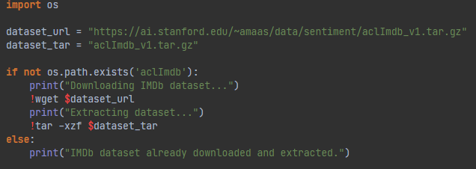
Dataset Overview
IMDb movie review dataset
10,000 reviews: 5,000 positive, 5,000 negative
NLP preprocessing applied
Processing
Os Library
TfidVectorizer
Removed stopwords using NLTK
TF-IDF vectorization (max 5,000 features)

Slide 4

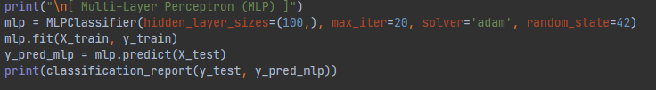

Model Overview
K-Means: Unsupervised clustering
Perceptron: Linear classifier
MLP: Deep neural network
Unsupervised learning algorithm for clustering
Groups reviews into clusters without using sentiment labels
Set to form 2 clusters (positive and negative) in this project
A simple linear classifier
Based on the concept of a weighted sum and activation function
Effective for linearly separable data
Multi-Layer Perceptron: a type of feedforward neural network
Consists of input, hidden, and output layers
Supports non-linear classification
Used with early stopping to prevent overfitting

Slide 5
Validation Results
Test Set Results
K-Means: 52.47%
Perceptron: 82%
MLP: 87%
K-Means: 51.27%
Perceptron: 82%
MLP: 85%

Slide 6
Confusion Matrix (MLP)
Loss Curve (MLP)
TN: 637
FP: 94
FN: 135
TP: 634
Training loss converged after ~20 epochs

Slide 7
Discussion
MLP is most accurate
Perceptron is solid for linear problems
Perceptron good for simple cases
K-Means lacks label guidance

Slide 8
References
A. L. Maas et al., “Learning Word Vectors for Sentiment Analysis,” Proc. 2ACL, pp. 142-150, 2011.
B. Liu, “Sentiment Analysis: Mining Opinions, Sentiments, and Emotions,” Cambridge Univ. Press, 2015.
A. Wang et al., “A Comparative Study of Sentiment Analysis Algorithms,” J. Artif. Intell. Res., vol. 55, pp. 1-35, 2016.
Y. Zhang et al., “Text Classification Algorithms: A Survey,” arXiv:1804.06291, 2018.
A. Joulin et al., “Bag of Tricks for Efficient Text Classification,” arXiv:1607.01759, 2016.
S. Bird et al., “Natural Language Processing with Python,” O’Reilly Media, 2009.
J. Ramos, “Using TF-IDF to Determine Word Relevance,” Proc. CIST, 2003.
C. Aggarwal, “Mining Text Data,” Springer, 2012.
T. Joachims, “Text Categorization with Support Vector Machines,” ECML, 1998.
Y. Kim, “Convolutional Neural Networks for Sentence Classification,” EMNLP, 2014.
A. Vaswani et al., “Attention Is All You Need,” NeurIPS, 2017.
J. Pennington et al., “GloVe: Global Vectors for Word Representation,” EMNLP, 2014.
J. Blitzer et al., “Biographies, Bollywood, Boom-boxes and Blenders,” Domain Adaptation Workshop, 2007.

